Slide 1
Hackathon Prototype Phase
- Team Ctrl + Alt + Elite

Slide 2
Team Members
- Team Ctrl + Alt + Elite
Tanush T M | NI D&O SAAT Inno&Bus Tools Dev Innov 2a
Suchitra | NI D&O SAAT Inno&Bus Tools Dev Innov 2a
Sangarathiriveni S | NI D&O SAAT Inno&Bus Tools Dev Innov 2a
Avinash M | NI D&O SAAT Inno&Bus Tools Dev Innov 4

Slide 3
Theme Details
AI-First Customer Support Ecosystem
Addresses telecom pain points — reduces high query volumes and manual dependency through intelligent automation.
Balances AI efficiency with human empathy — ensures quick resolutions while maintaining personalized, empathetic support.
Delivers business impact — cuts operational costs, improves response times, and enhances overall customer satisfaction.

Slide 4
Approach Details
AI-First Customer Support Ecosystem
Solution Approach — RAG-powered LLM answers routine telecom queries (billing, activation, roaming, network) end-to-end; when confidence is low or issue is complex, it escalates to a human agent with a concise AI summary for immediate continuation.
Balances AI efficiency with human empathy — Automation rate, Escalation rate, and Cost per ticket.
Core tech (high-level): LLM- Llama(Groq), Flask, React.js, Socket.io.
Assumptions: Knowledge base is available and reasonably organized; customer intents are mostly repetitive (billing, plan changes, SIM).

Slide 5
Approach Details
Constraints & decision points
Constraints: KB freshness; multilingual requirements; latency SLA for real-time chat.
Decisions & rationale: Choose RAG for accuracy on domain docs; vector DB for low-latency retrieval; cloud vs on-premises based on compliance and cost, for the future.
Implementation ease & effectiveness
Effort vs impact: Fast initial impact (automate 50–70% of top queries in MVP); with KB expansion and tuning expect ~80–90% automation for routine queries.
Human-in-loop ensures safety and improves trust while models mature..

Slide 6
Approach Details
Extent of scalability / usability
Scalable: Modular RAG + index design allows adding domains, languages, and channels without rearchitecting.
Usable: Agent dashboard with AI summaries minimizes training time for agents and preserves context across handoffs.

Slide 7
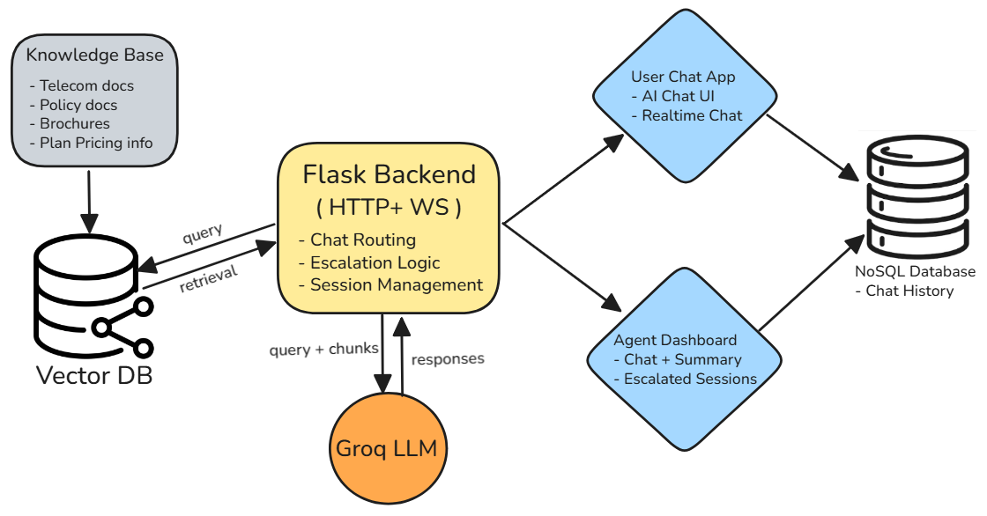
Architecture Diagram

Slide 8
Submission Links
Demo Link of a Working Prototype
Working Source Code with ReadMe file

Slide 9
End frame

